Slide 1

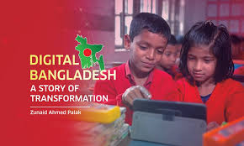
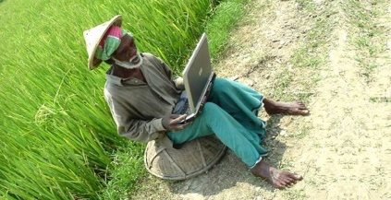
About Digital Bangladesh
Digital Bangladesh is a wonderful vision that is dreamt by the government and the literate class for the technological development of Bangladesh. It is an Idea that includes the IT use for management, administration and governance to ensure transparency, accountability.

Slide 2
Background Of Digital Bangladesh
On the eve of the election, Bangladesh Awami League, one of the major political parties, First declared vision 2021with the aim to turn Bangladesh into a digital country by the next decade. More than a month ago, the Bangladesh Computer Council also organized a computer fair with the theme "Digital Bangladesh". It refers to an e-state where all its activities of governance, commerce, education, agriculture etc will be powered by computer and internet.

Slide 3
Goals
Millennium Development Goals :
GOAL 1: Eradicate extreme poverty and hunger.
GOAL 2: Achieve universal primary education.
GOAL 3: Promote gender equity and empower women.
GOAL 4: Reduce child mortality.
GOAL 5: Improve maternal health.
GOAL 6: Connecting Citizens and Government
GOAL 7: Ensure environmental sustainability
GOAL 8: Develop a global partnership for development

Slide 4
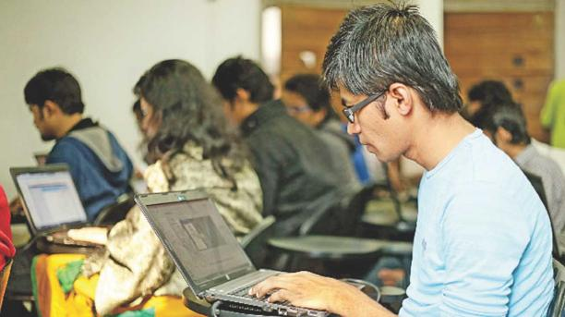
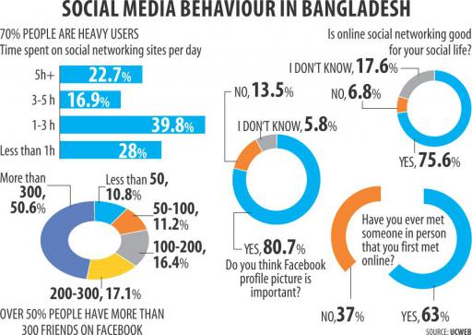

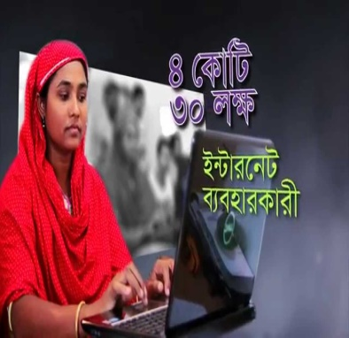
Achievement
• Educational sector.
• Social sector.
• Agricultural sector.
• E - Commerce
• ICT sector

Slide 5
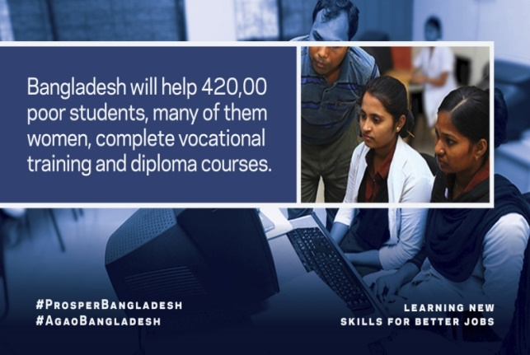
Education Sector
• Online Form Fill Up.
• ICT subject mandatory in school.
• Free education up to degree.
• Distributing books among the students at the first day of the year.
• Every School has a mandatory library equipped with necessary books.
• Online Form Fill Up.

Slide 6
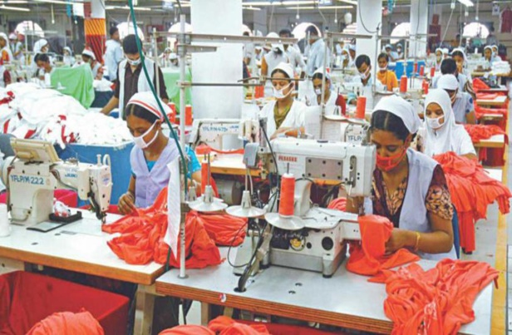
Social sector
• Rural development such as safe drinking water, sanitation and education.
• Vocational training institutes across the country produce skilled manpower both for
domestic and overseas employment.
• Women empowerment.
• Child mortality reduced.

Slide 7
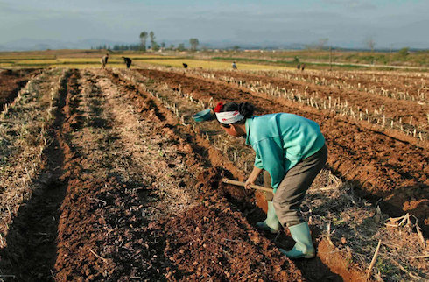
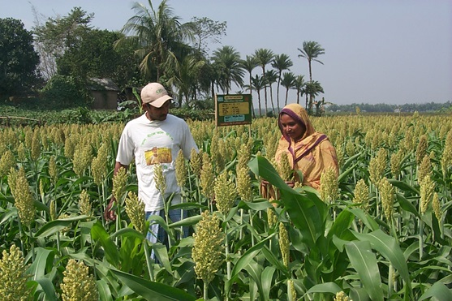
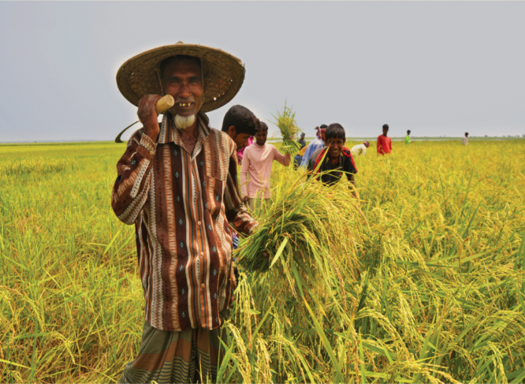
Agriculture sector
• Agriculture sector has grown annually at an average growth rate of 3.9 percent during
Awami League tenure.
• In 35 districts, government has arranged to supply tractors, power tillers, harvesters and
other agricultural equipment at 25 percent subsidized price.
• supply seeds and fertilizers to the farmers free of cost. • Introduced krishi call centers.
• Agriculture related information through SMS service
• Agriculture based bangla website.
• Agricultural input assistance

Slide 8
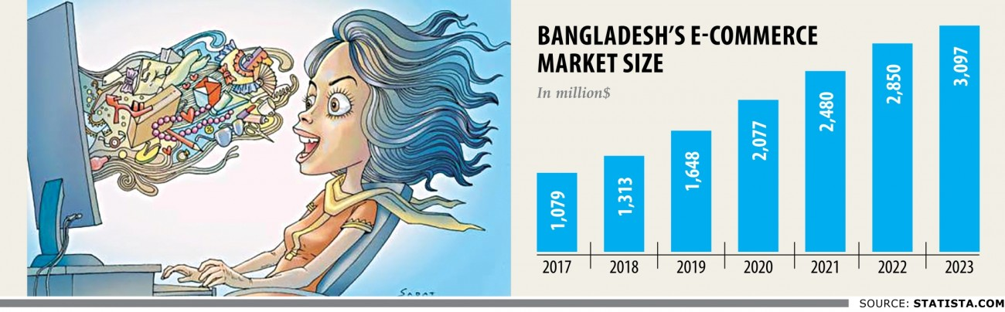
E-Commerce Sector
• Ready Made Garments (RMG).
• Banking sectors (Online Banking).
• Online Shopping.
• Web Hosting, Domain.
• Oil and Gas sector etc.
• Online Transportation System, Hotel Management and Tourism etc.

Slide 9

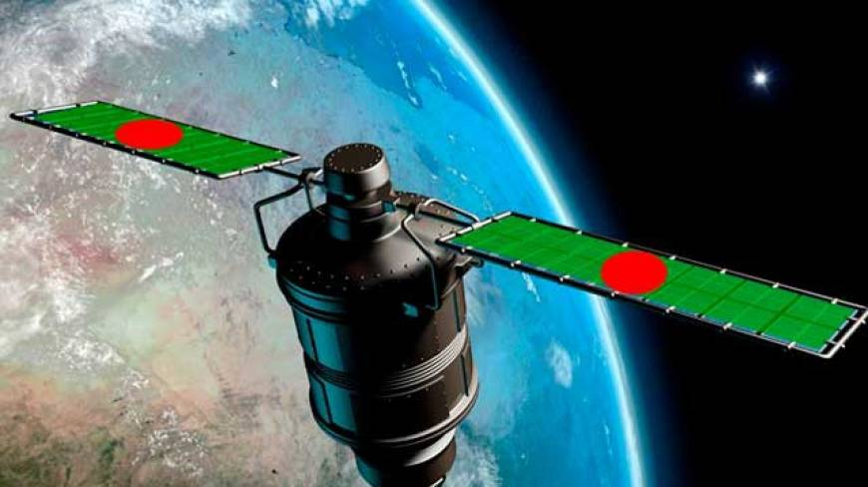
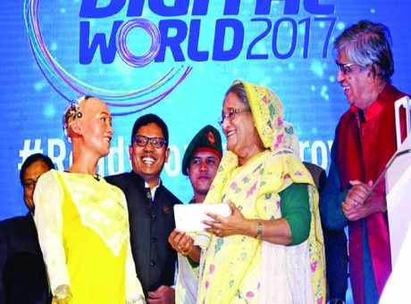
ICT Sector
Online information center:
• Digital Info Centers in Union and Upazila Parishads.
• Information Portals in all 64 Districts Managed by DCs
• Disaster early warning through mobile network.
Connecting Citizens and Government:
• All 64 DC offices, PMO and Cabinet being connected with video conferencing.
• Community radio being explored.
Internet:
• Affordable bandwidth price.
• 4G service.
Satellite:
• BANGABANDHU-1 Satellite.

Slide 10
Challenges
Lacking Manpower:
• less people to expand the IT sector.
• lack of baseline information.
• lack of vocational training institute.
• lack of opportunities for women.
• Lack of invitation for the youngsters .
• Tendency od moving abroad

Slide 11
Challenges
Lack of professionalism:
• Lack of scope to develop software industry
• Scarcity of skilled team leader /manager
• Lack of eagerness to achieve INT. Recognition
• Lack of knowledge among GOVT. stocks holders
• Immense interest for other Businesses
• Lack of resources and structural limitations.
• Insufficient “EQUAL -CAPITAL DEVELOPMENT FUND”.

Slide 12
Thank you

